Slide 1



DSI 18
Jonathan Goh
Capstone Project

Slide 2
The Acea Group is one of the leading Italian multiutility operators that manages and develops water and electricity networks and environmental services. Its water services supply a total of 9 million inhabitants in Lazio, Tuscany, Umbria, Molise and Campania regions of Italy.
Water supply companies struggle with the forecasting of water levels in the various waterbodies they manage (water spring, lake, river, or aquifer) to handle daily consumption.

Slide 3

A dataset containing rainfall, temperature, volume drawn, hydrometry and depths at various locations linked to the Auser Aquifer was provided.
This waterbody consists of two subsystems, split into north and south, where the former partly influences the behavior of the latter. The levels of the north subsystem are represented by the depths of the SAL, PAG, CoS and DIEC wells, while the levels of the south subsystem are represented by the depth of the LT2 well.
The features to be predicted for this project are the depths of the SAL, CoS and LT2 wells. Features like rainfall and temperature affect features like depth to groundwater and hydrometry some time after. However, it is unknown how many days, weeks or months later that these effects are observed.
This project aims to build models that can forecast the depths of the targeted variables 7 days ahead. EDA, data cleaning and feature engineering will be performed on the dataset given. Following which, time series and regression models will be tried to see which of these give the lowest RMSE.

Slide 4
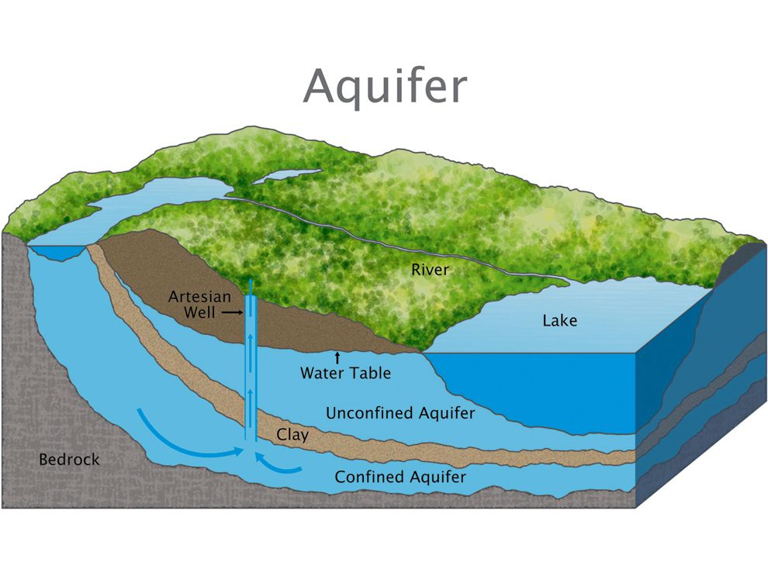
WHAT IS AN AQUIFER?
An aquifer is an underground layer of water-bearing permeable rock, rock fractures or unconsolidated materials (gravel, sand, or silt).
Groundwater can be extracted using a water well.

Slide 5
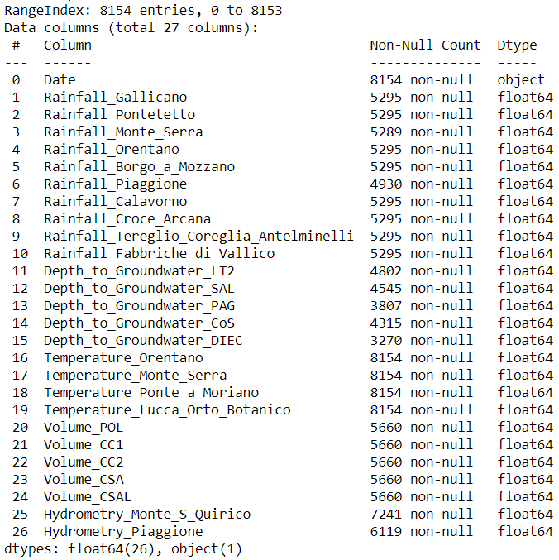
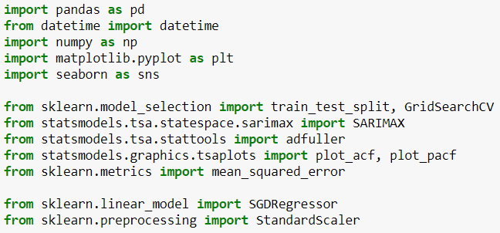
Dataset summary
And
Tools & Libraries used

Slide 6
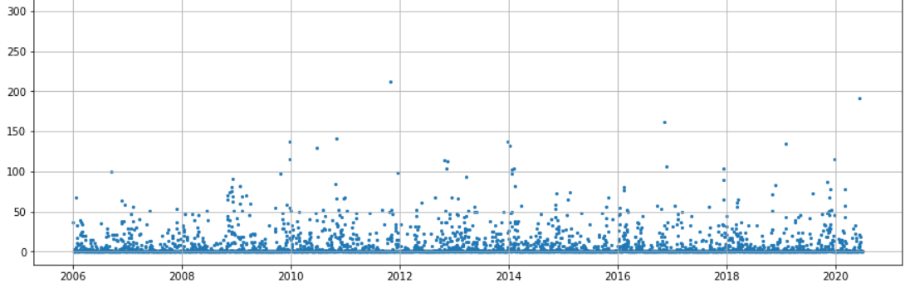
Rainfall data
Measured at Gallicano between 2006 to 2020

Slide 7
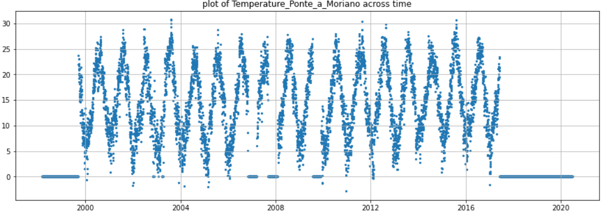
Temperature data
Measured at Ponte A Moriano between 1999 to 2017

Slide 8
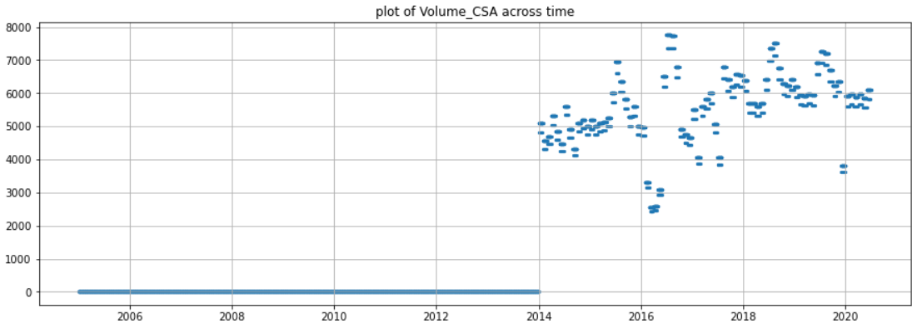
Volume of water drawn
Volume of water drawn at point CSA between 2014 to 2020

Slide 9
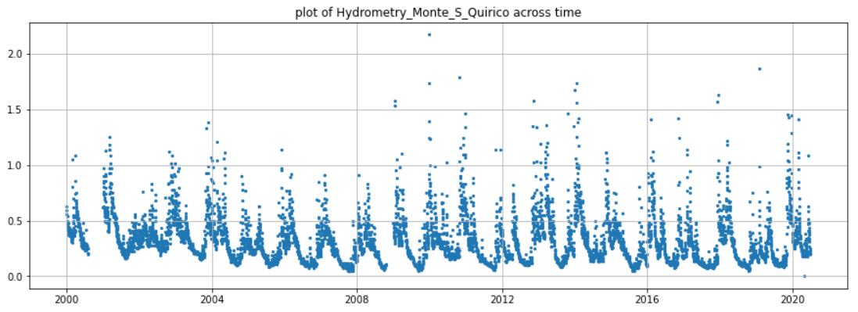
Hydrometry measurements
Hydrometry measurement at Monte S Quirico between 2000 to 2020

Slide 10
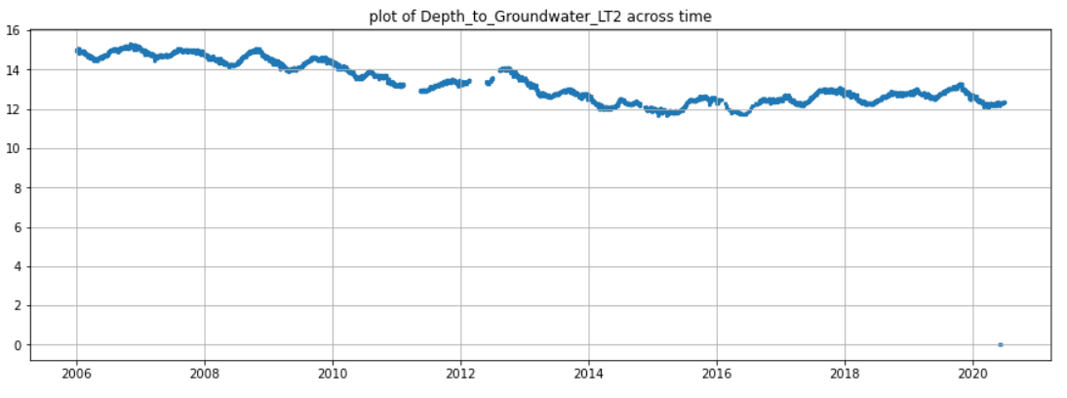
Depth to water
Measured at LT2 well between 2006 to 2020
Target variable 1

Slide 11
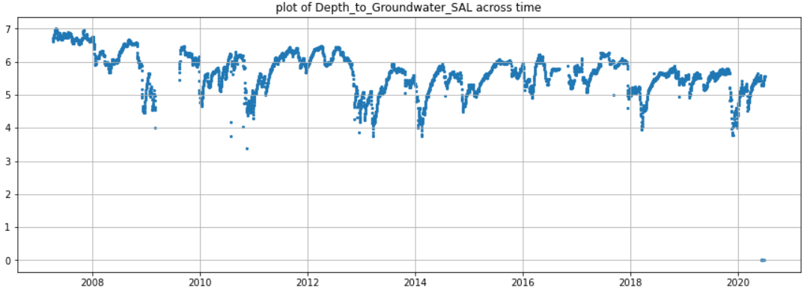
Depth to water
Measured at SAL well between 2007 to 2020
Target variable 2

Slide 12
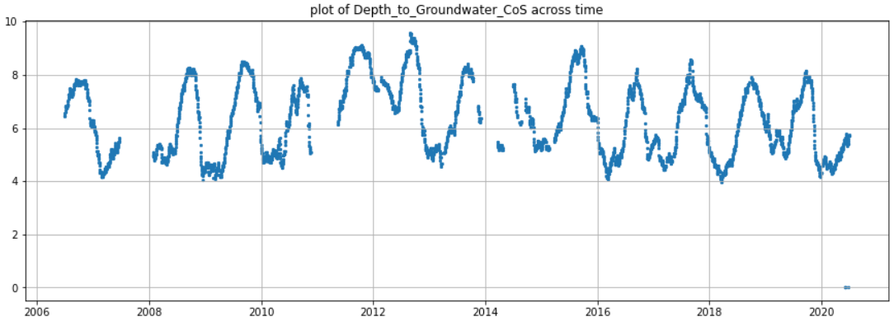
Depth to water
Measured at CoS well between 2006 to 2020
Target variable 3

Slide 13
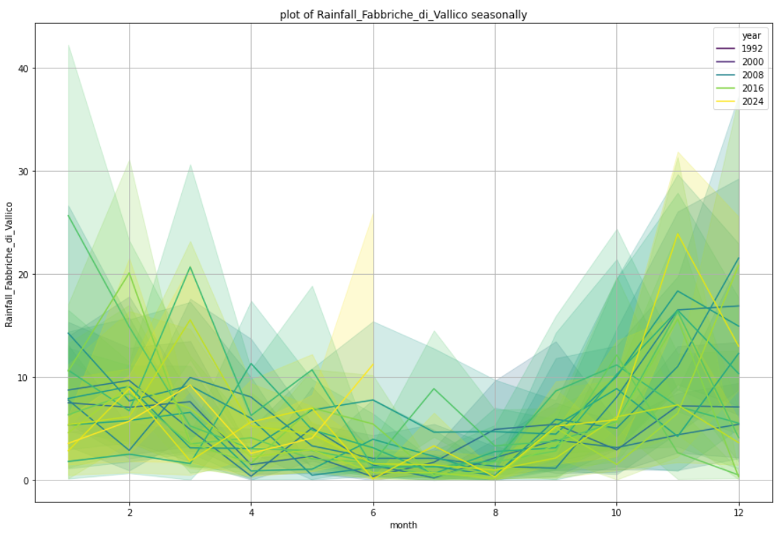
Rainfall by month
Measured at Fabbriche di Vallico
Drier season in middle of year
Rainy season during year start/end

Slide 14
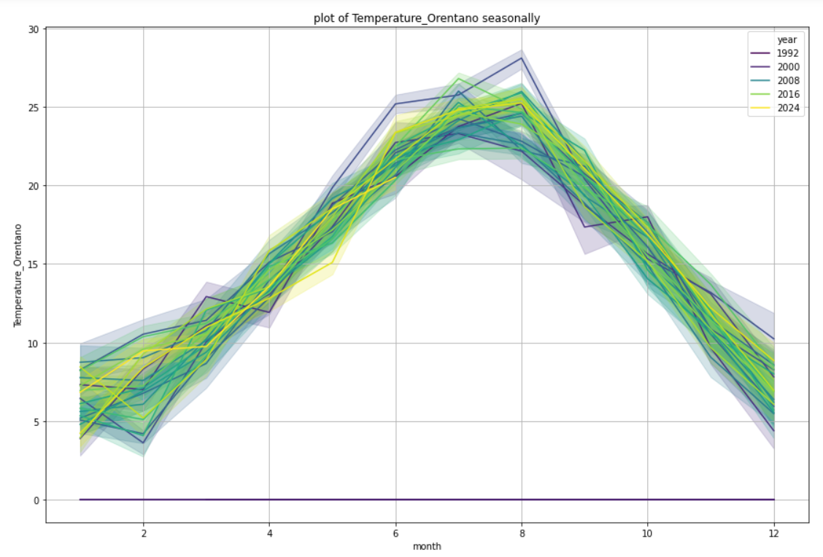
Temperature by month
Measured at Orentano
Hot season in middle of year
Cool season during year start/end

Slide 15
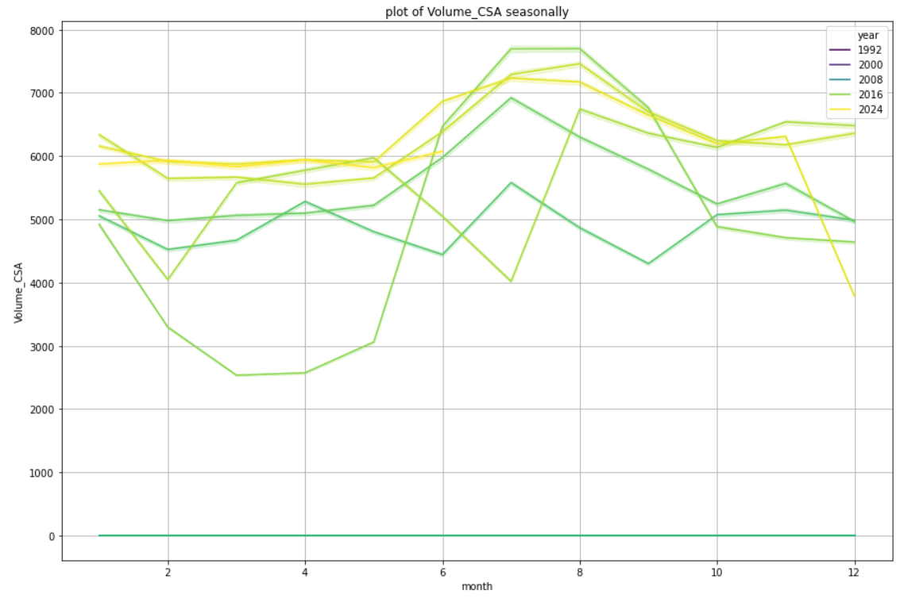
Volume drawn by month
Metered at CSA
Generally higher offtake in the middle of the year

Slide 16
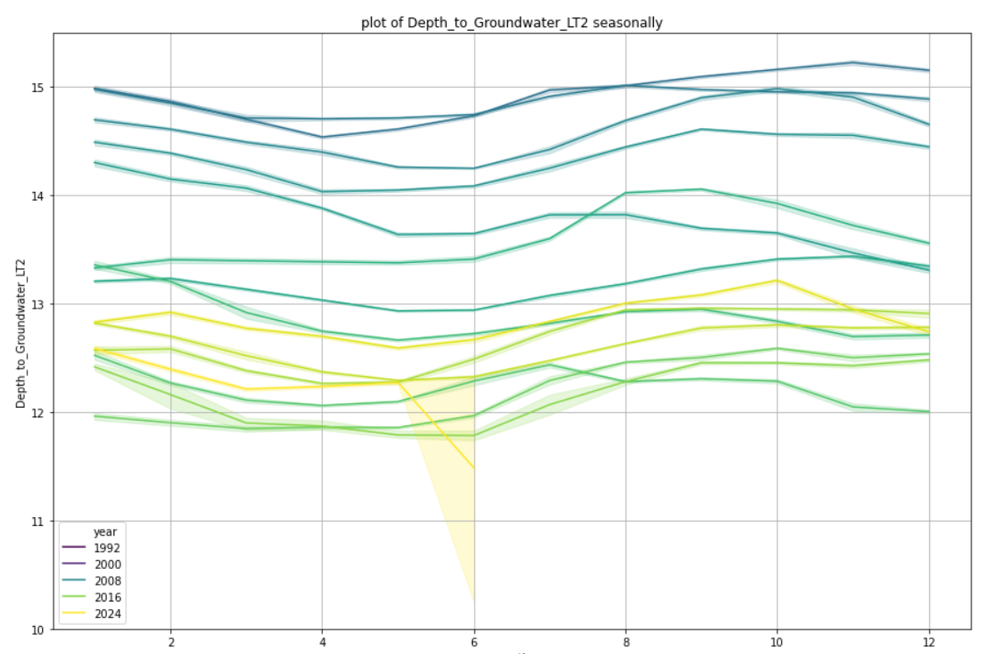
Depth to Groundwater by month
Measured at LT2
Depth values are generally lowest around March and highest in around September.
Water is closer to the surface after winter and is further away from the surface after summer.

Slide 17
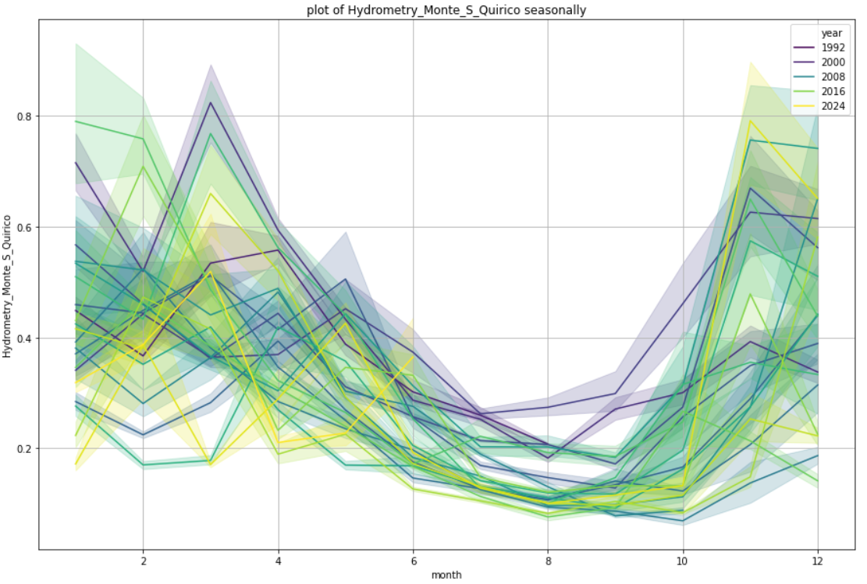
Hydrometry by month
Measured at Monte S Quirico
Measured values are generally highest around March and lowest in around September.
Water is closer to the surface after winter and is further away from the surface after summer.

Slide 18
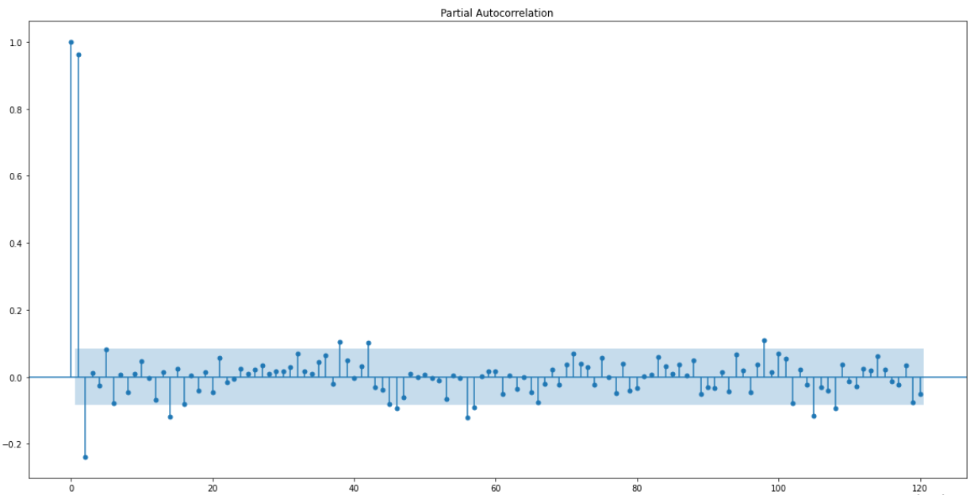
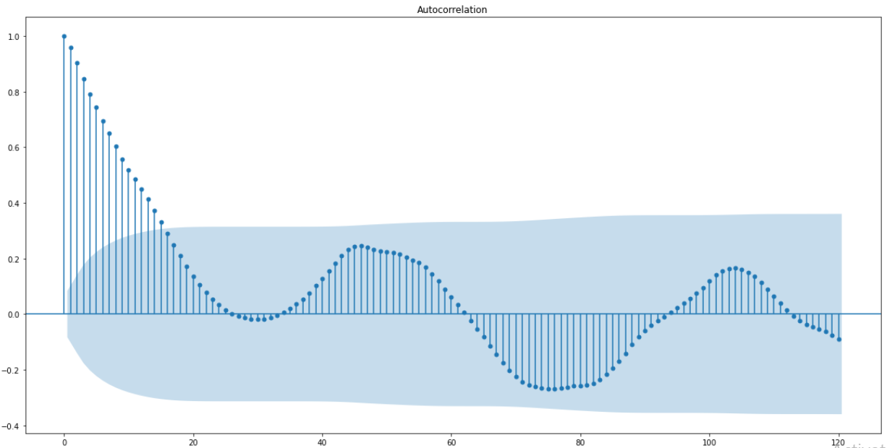

SARIMA Model on Depth to SAL
p-value for Dickey Fuller test: 0.00106 -> fulfils stationarity condition
PACF and ACF plots -> (p, d, q) is (2, 0, 0)
Seasonal order from GridSearch -> (2, 0, 1, 52)
RMSE = 43cm and 68% of standard deviation

Slide 19
Preparing for Regression
Values for the features of Volume CSA & CSAL from before 2014 were all zeros. Since these features are independent variables to be used as predictors, only data from 2014 onwards will be used.
Temperature Ponte a Moriano contains 0 values from 2017 onwards indicating that the field instrument failed and wasn't replaced/repaired. This feature will be dropped.
Some 0 values and null values were observed in most of the features. 0 values are taken to be instrument failures and are thus replaced with null and subsequently filled by interpolation.
Extracted year as a feature column
Extracted month and did cyclical encoding for use as a feature column

Slide 20
Preparing for Regression
Roll 7 to smooth out short term fluctuation
Shifting by a range of days since the number of days after that water depths are affected by rainfall and temperatures are unknown.
7 days is the minimum since the model is meant to serve as a week-ahead forecast.
After each shift, the correlation with the target variable is computed and stored.
Correlation vs. the number of days shifted is plotted to find the highest correlation.
The number of days shifted that corresponds to the highest correlation for each of the rainfall and temperature features is extracted and stored in a dictionary
The features are then shifted by the number of days that correspond to the highest correlation by iterating over each key-value pair in the dictionary
All other features are shifted by 7 days since the model is intended to be a week-ahead forecast.

Slide 21
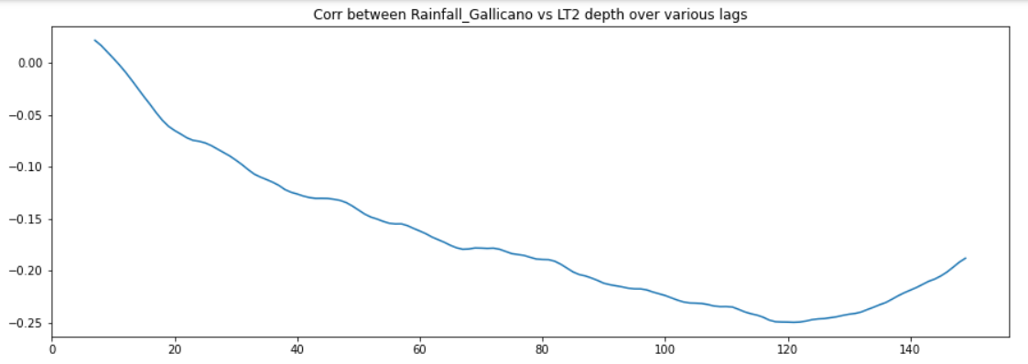
Plotting correlation vs shift

Slide 22
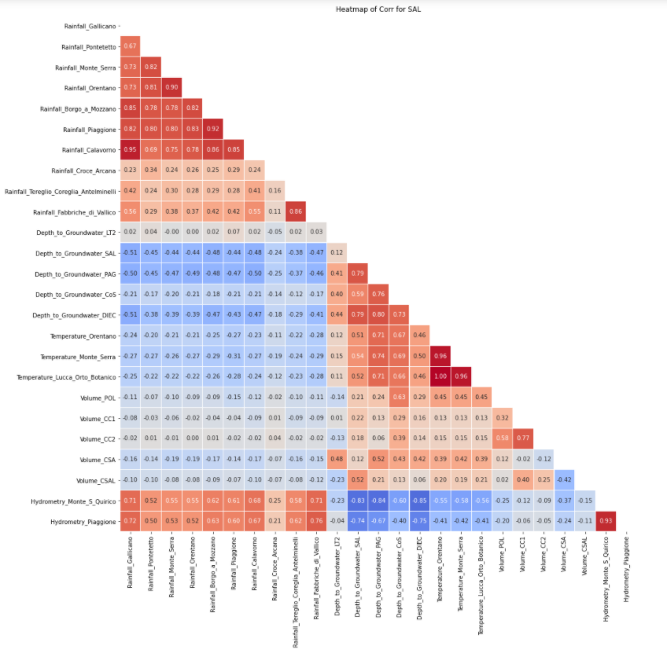
Heatmap of SAL after shift

Slide 23
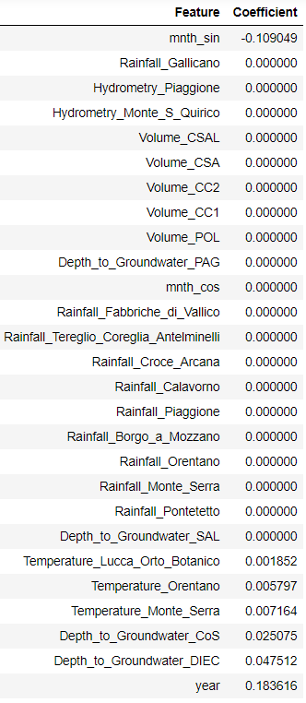
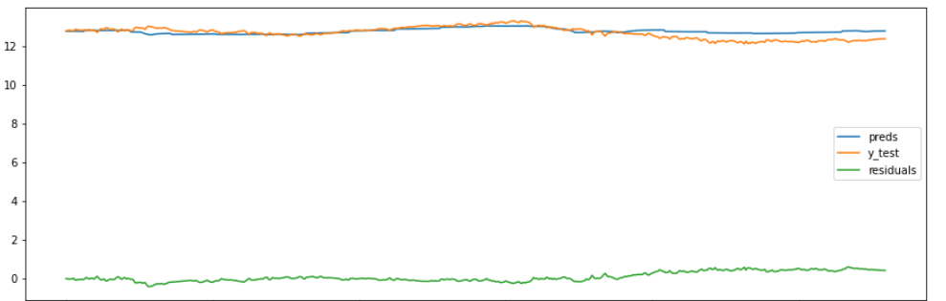
Stochastic Gradient Descent (SGD) Regressor Model for LT2 Depth
Gridsearch returned best params as:
alpha = 0.1
Penalty = L1
RMSE = 25cm and 24% of standard deviation

Slide 24
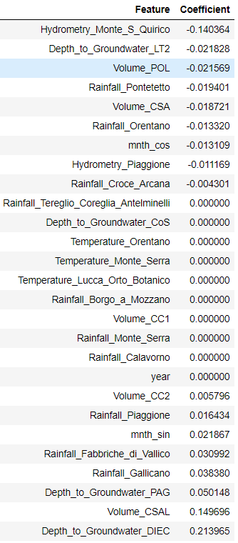
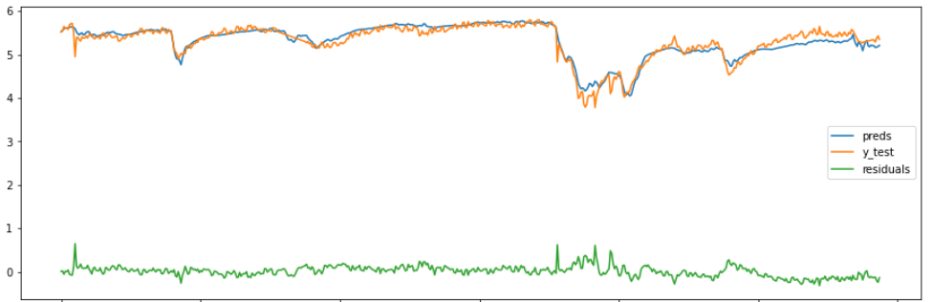
Stochastic Gradient Descent (SGD) Regressor Model for SAL Depth
Gridsearch returned best params as:
alpha = 0.1
Penalty = Elastic Net
RMSE = 12cm and 19% of standard deviation

Slide 25
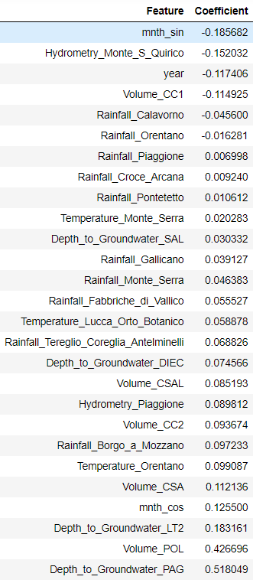
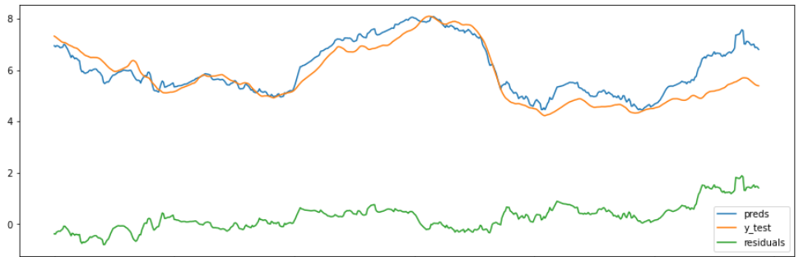
Stochastic Gradient Descent (SGD) Regressor Model for CoS Depth
Gridsearch returned best params as:
alpha = 0.1
Penalty = L2
RMSE = 57cm and 41% of standard deviation
Ignoring last 100 days, RMSE was 38cm and 28% of standard deviation

Slide 26
Conclusion & Recommendation
Predicting the water level to be within an error margin of 25cm, 12cm and 38cm for the depths at LT2, SAL and CoS respectively represents a reasonable degree of success when compared to the original standard deviation as a baseline
Predicting the depth at SAL had the best RMSE scores while predicting the depth at CoS fared the poorest among the regressors.
SARIMA model attempt for depth at SAL performed worse than all the regression models in terms of RMSE.
Success of the regressor model in predicting the depth at SAL shows that regression with features such as water level measurements at nearby locations, rainfall measurements, temperature measurements and metering the volume of water drawn can play a vital role in predicting water availability.
However, these same features had little importance when it came to predicting LT2.
It was also noted from the background information given in Kaggle by the competition host that the Auser waterbody is split into North and South
It could be possible that the majority of the predictor variables in the dataset given were mainly from the north sector.
Additional data collection from the south sector is required to proceed further.
An alternative means to this would be a more advanced time series approach whereby the predicted variable is predicted solely based on past values.
Data points in the last few months of the dataset for the depth at CoS seems to be uncharacteristic when compared to trends from previous years. Further study on this is necessary to identify the reason why before a better model can be built. Possible reasons include:
This could be due to changes in human behavior brought about by COVID-19
Possible instrument malfunction since there were some zero values in the original dataset for this period as well
All models to be retrained periodically at a suitable interval depending on the level of accuracy required by the user since the residuals generally increase the further away the predicted date is from the data it is trained on

Slide 27

THANK YOU!

